Slide 1
CANSO
PBN Support Phil Rakena
CANSO PBN SG co-Chair
Regional PBN Champion
[Airways New Zealand]

Slide 2
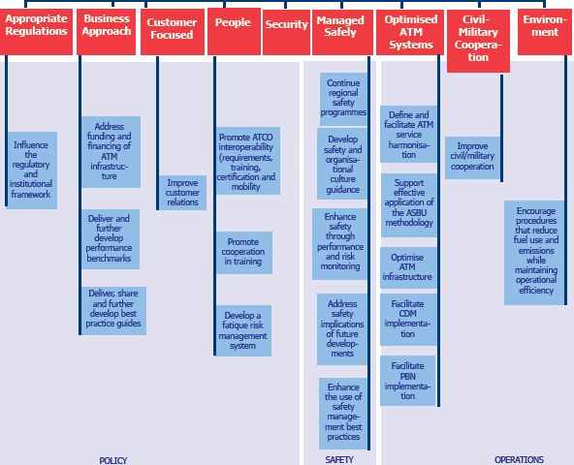
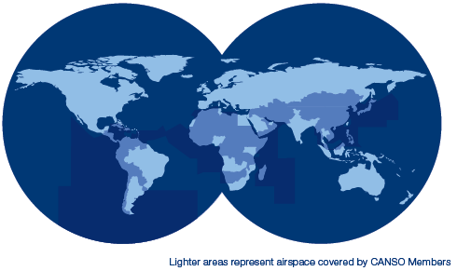
CANSO – Civil Air Navigation Services Organisation
PBNSG Mission: “Act as the CANSO focal point for all PBN matters, and support members to achieve successful PBN implementation.”

Slide 3
PBN SG Work Programme
Publish PBN Best Practice Guide
Develop PBN Performance Metrics
Develop PBN Vision 2020-30
APAC Enroute PBN Harmonisation
Build Partnerships – ICAO PBN SG
Address Member Issues

Slide 4
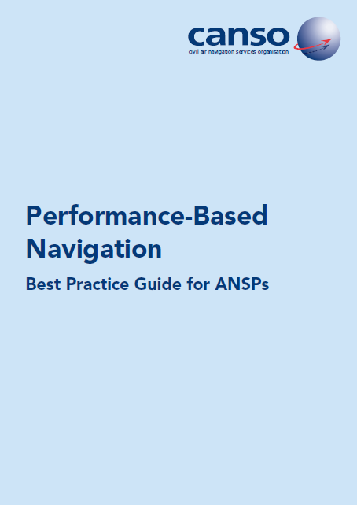
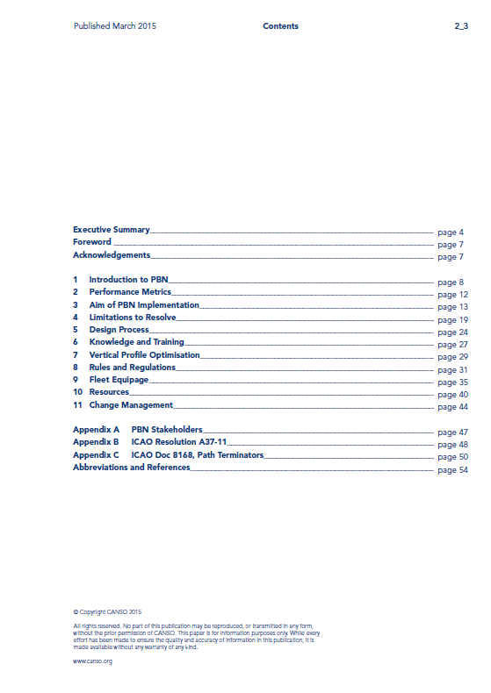
CANSO PBN Best Practice Guide for ANSPs
Addresses key PBN issues for ANSPs
Regulations, Resources, Fleet Equipage, Knowledge & Training
Notes:
(Living document)

Slide 5
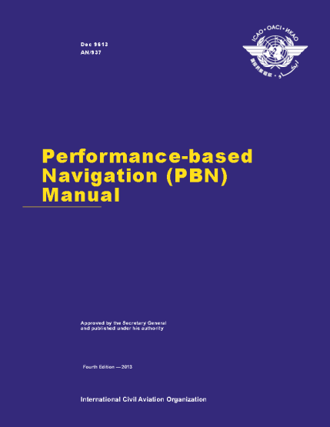
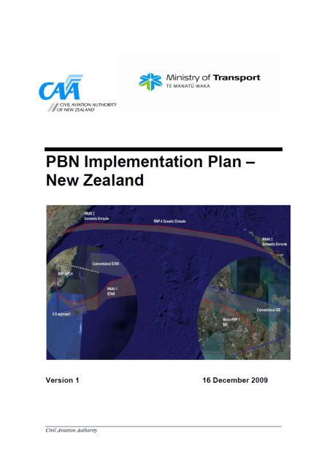
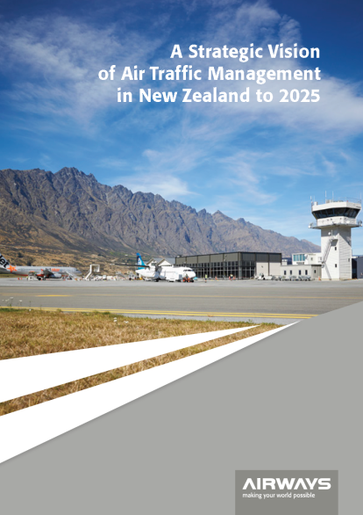
CANSO PBN Best Practice Guide for ANSPs
Rules and Regulations
Aligned State/Regulator, ANSP and Industry plans
Cooperation is critical
Knowledge of:
Nav/Surveillance Infrastructure
Operator and ANSP procedures
Rules and Approvals Process in place
Notes:
(Living document)

Slide 6
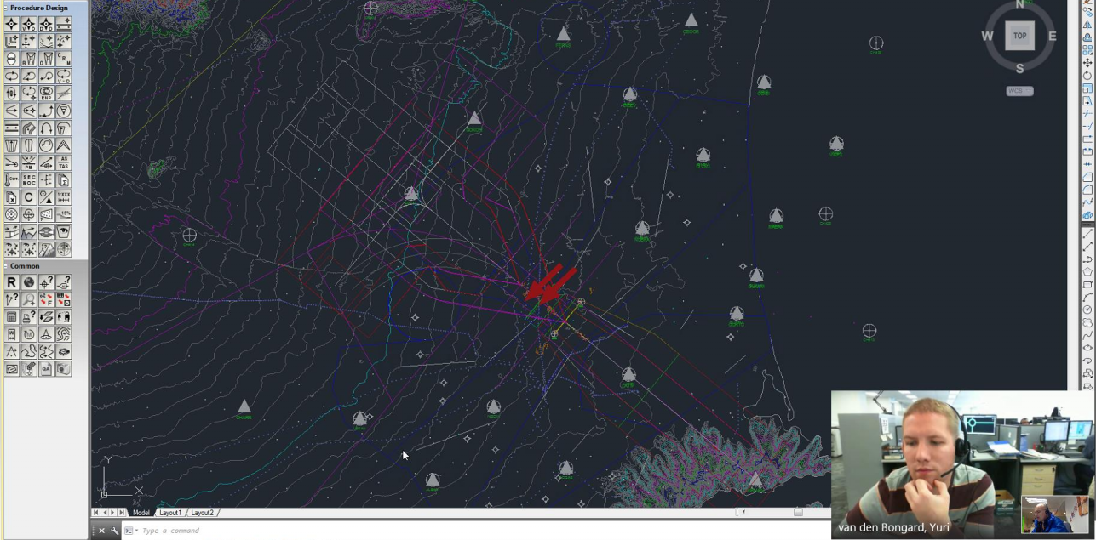
CANSO PBN Best Practice Guide for ANSPs
Resources
PBN Experts & Project Managers
ATC, Simulation, ATM Software, Designers, Charting
Policy & Standards, Safety & Risk, Performance, Finance
Education and Communication
Change Management
Notes:
(Living document)

Slide 7
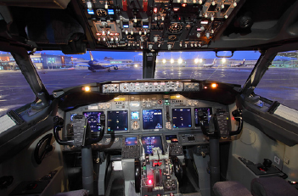
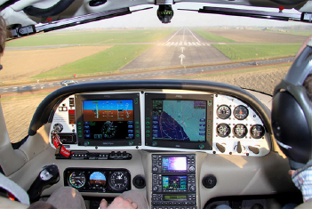
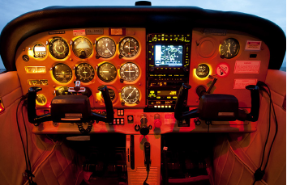
CANSO PBN Best Practice Guide for ANSPs
Fleet Equipage
Mixed FMS/Avionics
Mixed Mode PBN vs Conventional Mode
High / Low Performance
Collaboration
Operators
Regulator
ANSP
Notes:
(Living document)

Slide 8
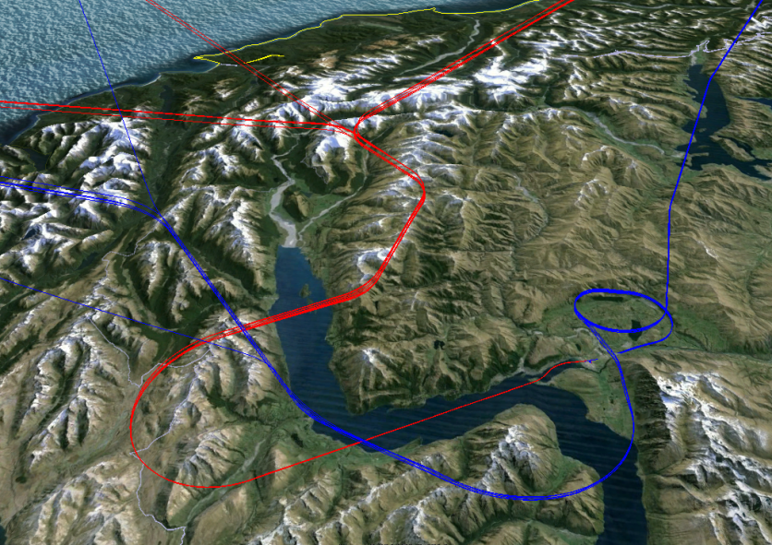
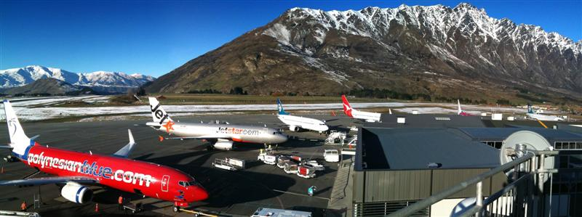
CANSO PBN Best Practice Guide for ANSPs
Knowledge and Training
Decision-makers
Implementers
Pilot / ATC users
Range of media to educate
Existing PBN resources
Cross train if able
Notes:
(Living document)

Slide 9
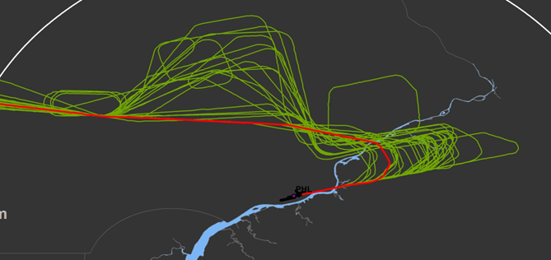
PBN Performance Metrics
Develop PBN Performance Metric KPIs with OPWG
Assess PBN pre- / post- implementation
Prioritise implementation; Identify benefits
Support the business case for investment
Adding performance guidance to PBN BPG.

Slide 10
PBN Vision 2020-2030
Develop a CANSO PBN Vision 2020-2030
Consult with WGs and ICAO/IATA/ACI
Produce PBN position paper / policy document
Identify barriers to achieving Vision
Work with ICAO/IATA/ACI to implement change.
PBN
2020-30

Slide 11
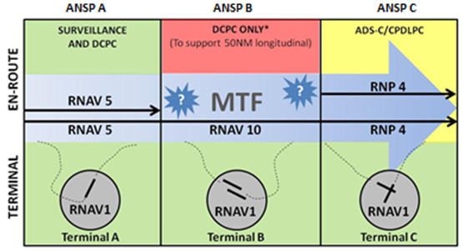
CANSO APAC OPS WG
Enroute PBN Harmonisation

Slide 12
Building Partnerships
Participate in ICAO PBN SG
Represent CANSO at ICAO PBN SG forum
Elevate needs of CANSO members
Support PBN implementation progress.
Support PBN Go Teams
Develop PBN ties with ICAO / IATA / ACI

Slide 13
Member PBN Issues
ICAO Standards – RTF, Track/HP/VFR Seps
Noise Impact
Airspace Containment
…
[ RNP AR Noise Video ]

Slide 14
Questions?
CANSO Headquarters
Transpolis Schiphol Airport
Polaris Avenue 85e
2132 JH Hoofddorp
the Netherlands
tel: +31 (0)23 568 5380
fax: +31 (0)23 568 5389
email: info@canso.org

